Slide 1
Chapter 13
Pakistan Capital Market
(Capital markets consist of PSX, the National Clearing Company of Pakistan Limited (NCCPL), the Central Depository Company (CDC), and the Pakistan Mercantile Exchange Limited (PMEX).
The Securities Exchange Commission of Pakistan (SECP) serves as a regulatory body for smooth functioning of these capital markets)

Slide 2
Securities and Exchange Commission of Pakistan (SECP) (1 OF 3)
Set up in pursuance of the Securities and Exchange Commission of Pakistan Act, 1997 and became operational on January 1, 1999.
Functions:
Regulation of corporate sector and capital market
Supervision and regulation of insurance companies
Supervision and regulation non-banking finance companies and private pensions schemes
Oversight of various external service providers to the corporate and financial sectors, including chartered accountants, credit rating agencies, corporate secretaries, brokers, surveyors etc.

Slide 4
THE SECURITIES AND EXCHANGE POLICY BOARD (2 OF 3)
provide guidance to the Commission in all matters relating to its functions and to formulate policies in consultation with the Commission
Advising the Government on matters falling within the purview of the Act and other corporate laws
To express its opinion on policy matters referred to it by the Government or the Commission.
Note: According to the Act, the Policy Board shall consist of a maximum of eleven members appointed by the Federal Government, including five ex-officio members and six from the private sector.

Slide 5
COMMISSION (3 OF 3)
The Commission is a collegiate body (currently five members) with collective responsibility.
Operational and executive authority of the Commission is vested in the Chairman who is the Commission’s CEO.
CEO is assisted by the Commissioners, especially for overseeing the working of various operational units as may be assigned by him.
https://www.secp.gov.pk/

Slide 6
Pakistan Stock Exchange (PSX)
Established on September 18, 1947 and was formally incorporated on March 10, 1949 under the name of ‘Karachi Stock Exchange’, as a Company limited by Guarantee.
In October 1970, a second stock exchange was established in Lahore to meet the stock trading needs of the provincial metropolis.
In October 1989, Islamabad Stock Exchange was established to cater to the investors of the northern parts of the country.
Because the three exchanges had separate management, trading interfaces, indices, and had no mutualized structure, therefore the Stock Exchanges (Corporatization, Demutualization and Integration) Act, 2012 was promulgated by the Government of Pakistan which ultimately resulted in the three exchanges integrating their operations effective January 11, 2016 under the new name ‘Pakistan Stock Exchange Limited’ (PSX).

Slide 7
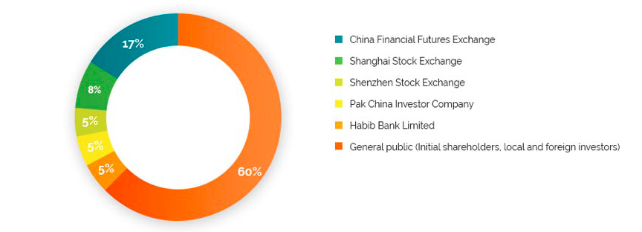
The objective of PSX is to provide a safe, reliable, efficient and consistent marketplace where investors can buy and sell common stock of listed companies and other securities.
Legal Framework: https://www.psx.com.pk/psx/regulations/legal-framework
Pattern of Shareholding:

Slide 8
PSX indices (1 of 2)
KSE 100 Index (The Index represents 85% of all the market capitalization of the Exchange. It is calculated using Free Float Market Capitalization methodology)
KSE 30 Index (includes the top 30 most liquid companies listed on PSX based on Free Float methodology)
KSE All Share Index (Consists of all listed companies on PSX based on Full Cap methodology)
KMI 30 Index (tracks the 30 most liquid Shariah compliant companies listed at PSX. The companies are weighted by float adjusted market capitalization with a 12% cap on weights of individual companies)

Slide 9
PSX Indices (1 of 2)
PSX KMI All Shares Index (comprises of all Shariah compliant companies listed on the Pakistan Stock Exchange Limited. The Index was developed by Pakistan Stock Exchange Limited and Meezan Bank Limited)
BKTi Tradable Banks Index (based on the listed companies in the banking sector. The Index tracks at least 80% free-float market capitalization of the Banking Sector)
OGTi Tradeable Oil & Gas Index (The Tradable Oil & Gas Index tracks at least 80% free-float market capitalization of the Oil & Gas Sector)
https://www.psx.com.pk/psx/product-and-services/indices#islamic-indices

Slide 10
Central Depository Company (CDC)
Regulated by SECP
CDC is the sole entity handling the electronic (paperless) settlement of transactions carried out at the Pakistan Stock Exchange
All the market settlement is in book entry form
As per the Companies Act, 2017, CDC holds the status of Public Interest Company & Large Sized Company since it holds assets of general public in fiduciary capacity.
Legal Framework: https://www.cdcpakistan.com/about-us/legal-framework/

Slide 11
CDC’s Services
Central Depository System (CDS): Operate for all financial instruments traded in Pakistan Capital Market
Investor Account Services: Allows the retail and corporate investor to open and maintain custody accounts directly with CDC.
Trustee and Custodial Services: To Open-end and Closed-end Mutual Funds and Voluntary Pension Schemes
CDC Share Registrar Services Limited (Wholly owned subsidiary of CDC): Provides share issuing companies state-of-the-art facilities of registrar and transfer agents, including customer dealing on behalf of the companies
ITMinds Limited (Wholly owned subsidiary of CDC): Provides Business Process Outsourcing (BPO) services which include provision of back office accounting functions to the Mutual Fund industry

Slide 12
Centralized Information Sharing Solution for Insurance Industry (CISSII) (Developed and managed by CDC Pakistan): Offers online information sharing solution for the insurance industry. It allows insurance companies to share information such as acceptance of claims, postponed or declined risks, malpractices of agents and group life claims experience for the purpose of achieving greater efficiency and transparency in the industry.
eServices:A customer convenience initiative by CDC, in the form of a web portal offering the following free-of-cost facilities:
Centralized eIPO System: Applications for subscription of shares offered to general public can be made electronically and payments can be made by Internet/Mobile banking, ATMs etc., avoiding the hassle of physical submission of IPO application and visiting the bank.
eDividend Repository: Provides investors consolidated data of all their cash benefits due and credited by issuers, and in case their dividends have not been credited, the reason for non-disbursement of dividend will also be available.

Slide 13
National Clearing Company of Pakistan Limited (NCCPL)
Incorporated on July 3, 2001 but o full yperational in 2003-04 with the support of ADB
Providing clearing and settlement services to the Pakistan Stock Exchange Limited.
Replaced the separate and individual Clearing Houses of three Stock Exchanges, namely Karachi Stock Exchange, Lahore Stock Exchange and Islamabad Stock Exchange by a single and centralized entity.
The Operations of NCCPL are governed by the following:
NCCPL Regulations NCSS Procedures
Clearing Houses (Licensing and Operations) Regulations, 2016
The Companies Act, 2017 Income Tax Ordinance, 2001
Securities Act, 2015 Leveraged Markets and Pledging Rules, 2011
Income Tax Rules, 2002 NCCPL CKO Regulations, 2017
CKO Rules, 2016 Futures Market Act 2016
Listed Companies Corporate Governance Regulations, 2019

Slide 15
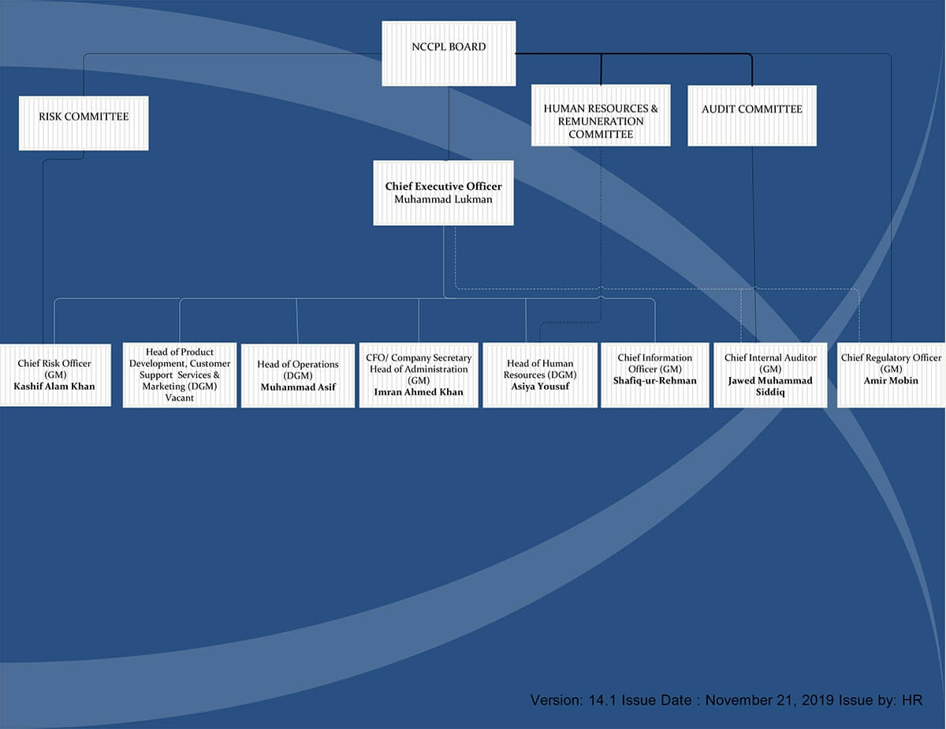
NCCPL Chart

Slide 16
Pakistan Mercantile Exchange Limited (PMEX)
formed in 2002 and started its operations in May 2007
PMEX is Pakistan’s first and only demutualized commodity futures exchange
Licensed and regulated by the Securities and Exchange Commission of Pakistan (SECP).
PMEX offers services in trading, clearing & settlement, custody as well as back office.

Slide 17
Products
International
Metal (Gold, Silver, Copper, Platinum, Palladium)
Energy (Crude oil, Brent Cude Oil, Natural Gas)
Agriculture (Cotton, Wheat, Corn, Soybean)
Equity Index
Local
Metal
Agriculture

